Slide 1
MS FLEXGRID CONTROL

Slide 2
OUTLINE
Introduction
Way to make tool
How to connect Datasource?
Required Properties

Slide 3
introduction

Slide 4
The Microsoft FlexGrid (MSFlexGrid) control displays and operates on tabular data. It allows complete flexibility to sort, merge, and format tables containing strings and pictures. When bound to a Data control, MSFlexGrid displays read-only data.
-You can put text, a picture, or both, in any cell of an MSFlexGrid. The Row and Col properties specify the current cell in an MSFlexGrid.

Slide 5
Way to make tool:
Project -> components -> MSFlexGrid Control 6.0
Project -> components -> Remote Data Control

Slide 6

MSFlexGrid Control
Remote Data Base Control

Slide 7
How to Connect
Datasource ?

Slide 8
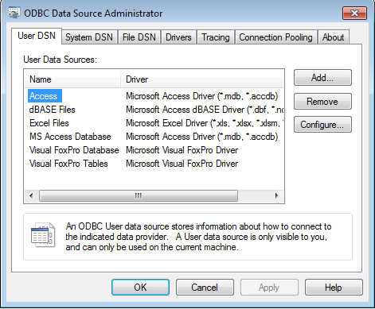
Go to Control panel -> Administrative tools -> Data source ODBC

Slide 9
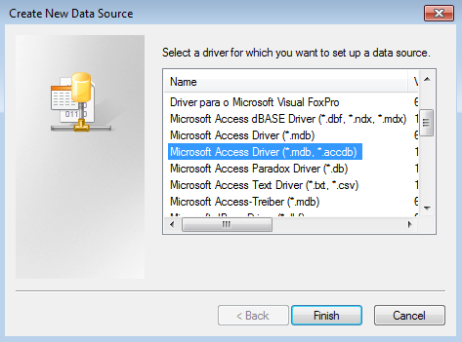
When u click add:

Slide 10
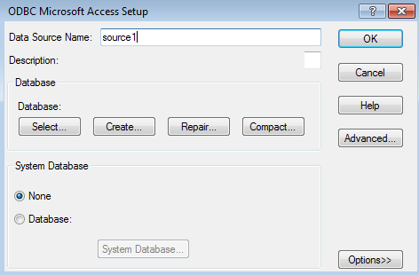
After the Finish button :

Slide 11
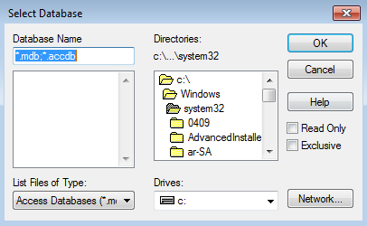
After the select button is given:

Slide 12
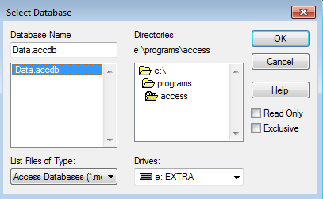

Slide 13
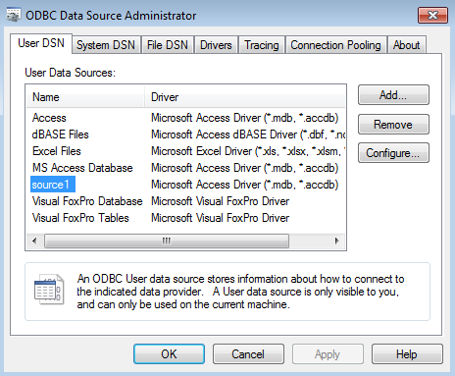

Slide 14
events
Click Event (ActiveX Controls)
KeyDown, KeyUp Events (ActiveX Controls)
KeyPress Event (ActiveX Controls)
Compare Event
DragDrop Event
DragOver Event
EnterCell Event

Slide 15
Properties
Text property references the contents of the current cell.
WordWrap property is set to True, the text wraps to the next line within the same cell
ColWidth property and RowHeight property can be used to adjust the column width and row height of Grid
Row and Col properties specify the current cell in an MSFlexGrid

Slide 16
Mandatory Properties:
Object | Property | Value
MSFlexGrid | DataSource | MSRDC1
MSRDC1 | DataSource Name | Source1
MSRDC1 | SQL | Select * from table name
TextBoxes | DataSource | MSRDC1
TextBoxes | DataField | Filed name

Slide 17
EXAMPLE

Slide 18
Coding:
Private Sub insert_Click()
MSRDC1.Resultset.AddNew
End Sub
Private Sub delete_Click()
MSRDC1.Resultset.Delete
End Sub
Private Sub edit_Click()
MSRDC1.Resultset.Edit
End Sub

Slide 19
Output

Slide 20
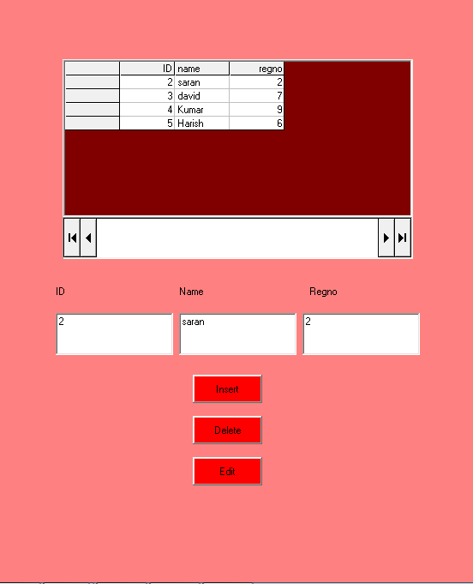

Slide 21
Inserting the record

Slide 22
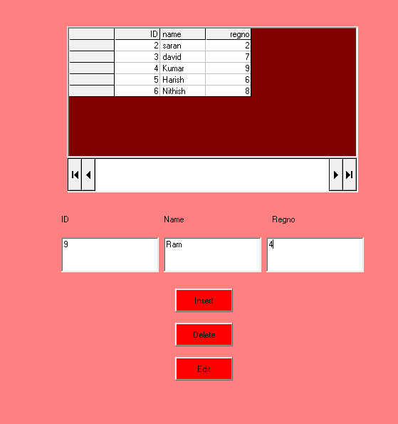

Slide 23
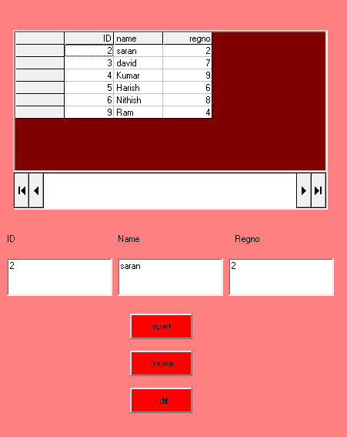

Slide 24
Deleting the record

Slide 25
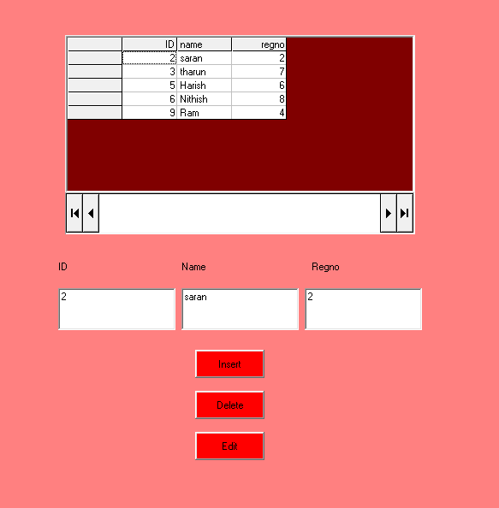

Slide 26
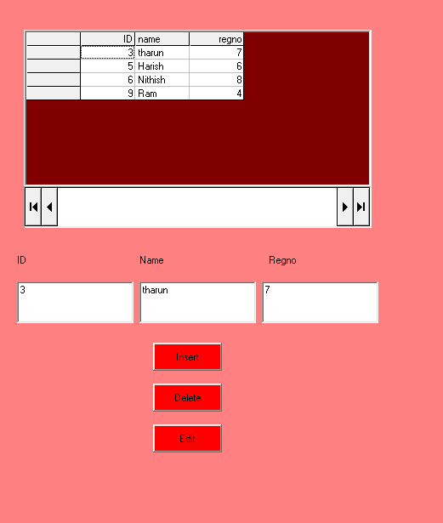

Slide 27
Editing the record

Slide 28
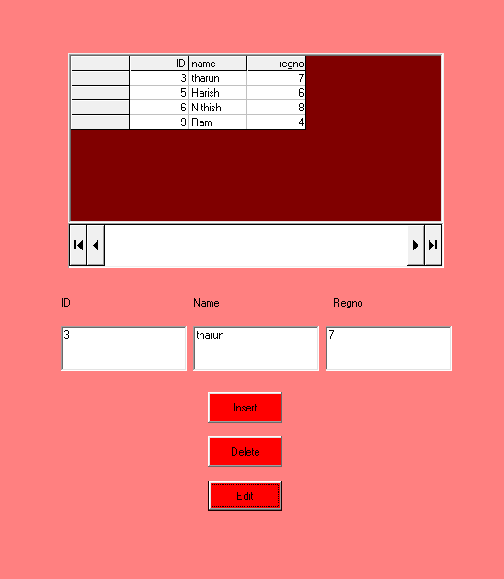

Slide 29
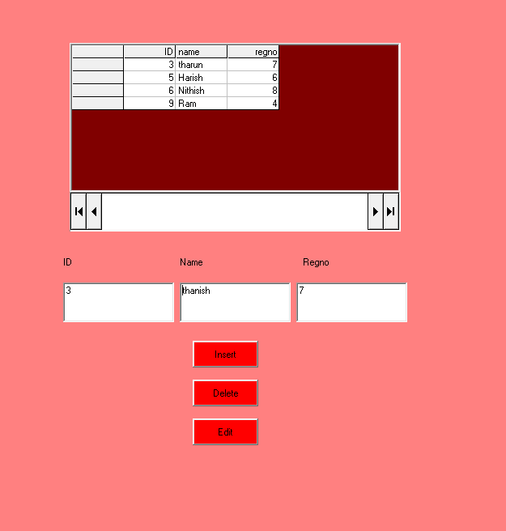

Slide 30
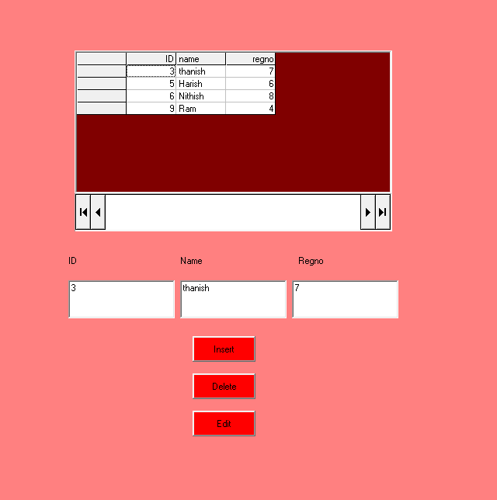

Slide 31
MICROSOFT DATA GRID CONTROL

Slide 32
CONTENT:
Data grid
create and connect the database
ADO control
Properties, methods and events of Datagrid

Slide 33
Data Grid:
Data Grid control appears similar to the Grid control; however, you can set the Data Grid control's Data Source property to a Data control so that the control is automatically filled and its column headers set automatically from a Data control's Record set object. The Data Grid control is really a fixed collection of columns, each with an indeterminate number of rows.

Slide 34
First create the database:
Go to Addins and then select visual data Manager.
click File → new → Microsoft access → version 7.0
Enter the file name and save it.
Database window will be displayed. In the database window,
right click on the properties. Select New table. Table structure
window will be displayed. In the table structure window,
Enter the table name and also add the fields by using “Addfield”
button. Click “Close” button.

Slide 35
Connect the database:
Go to control panel → administrative tools → data source
ODBC
ODBC dialog box will be displayed.
Select User DSN tab and click “Add” Button.
Click Microsoft Access driver(*.mdb,*.accdb) and click OK
Enter the data source name click “Select” button, select the
Database and click OK.

Slide 36
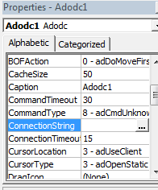
ADO control:
Connection string
Record Source
Connection String:

Slide 37
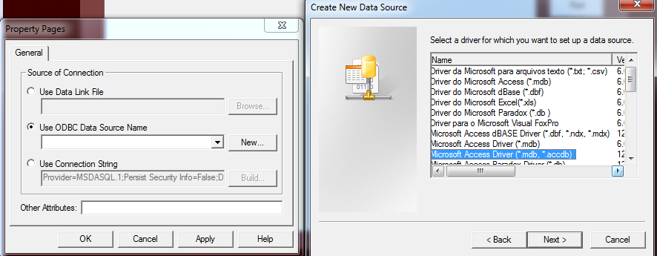

Slide 38
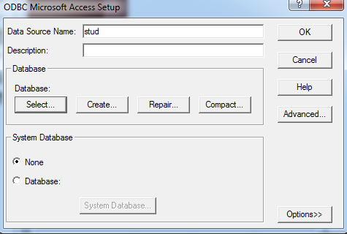

Slide 39
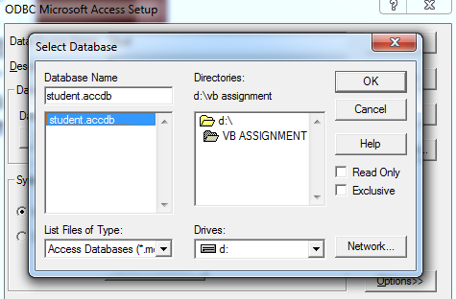

Slide 40
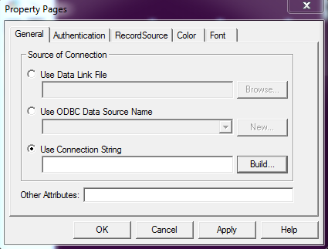
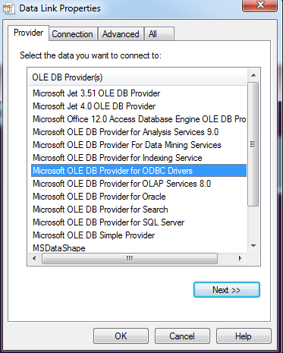

Slide 41
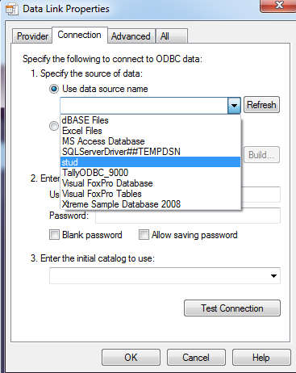
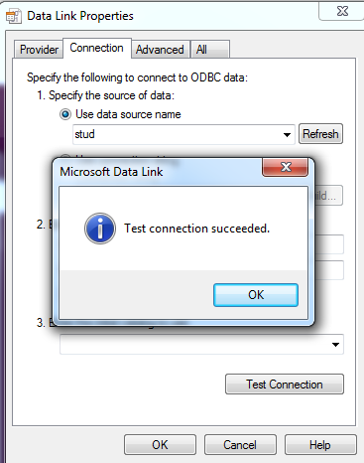

Slide 42
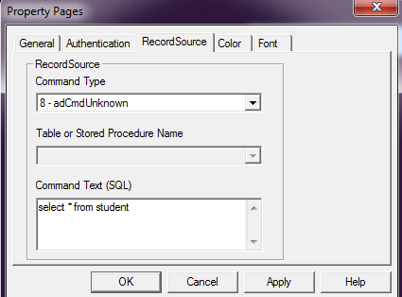
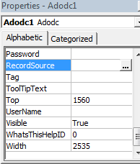
Record Source:

Slide 43
Data grid:
Data source
Data source:
In Data Source property, choose ADODC1 and
run the Application.

Slide 44
Properties:
AllowAddNew
AllowDelete
AllowUpdate
Backcolor
Caption
Align
DefColWidth
Font
ForeColor
Visiblerows
Selstartcol
selendcol.

Slide 45
Events:
Click
Aftercoledit
AfterDelete
AfterColUpdate
AfterUpdate
BeforeDelete
BeforeInsert
BeforeUpdate
Colresize
Buttonclick
Change
Mousedown
MouseUp
MouseMove.

Slide 46
Methods:
Clearfields
Clearselcols
Move
Drag
Rebind
RowTop
Scroll
SetFocus

Slide 47
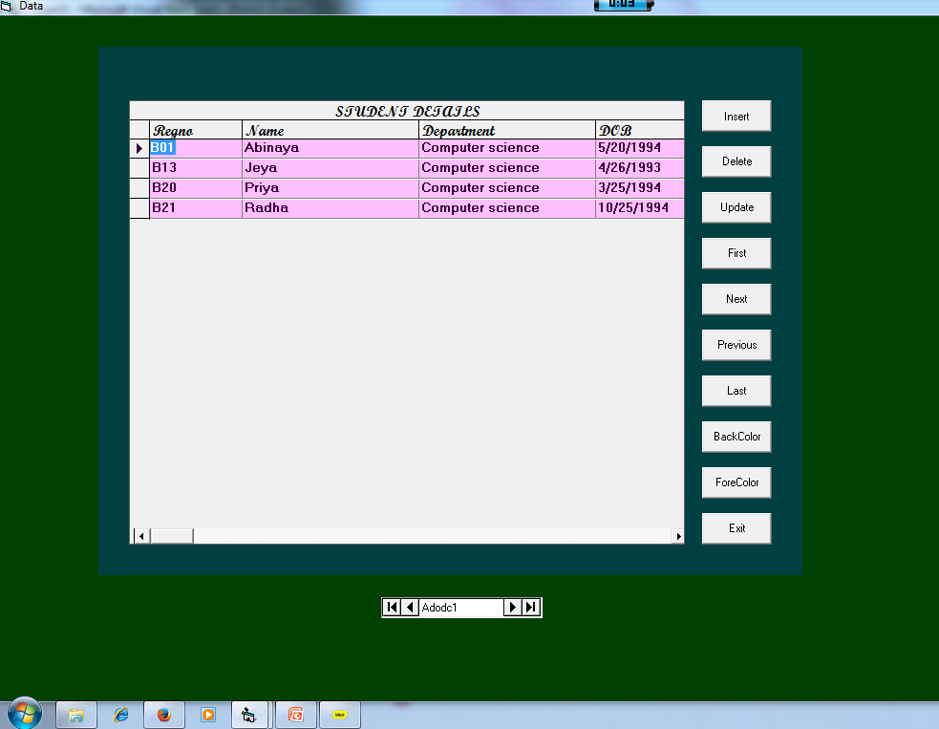

Slide 48
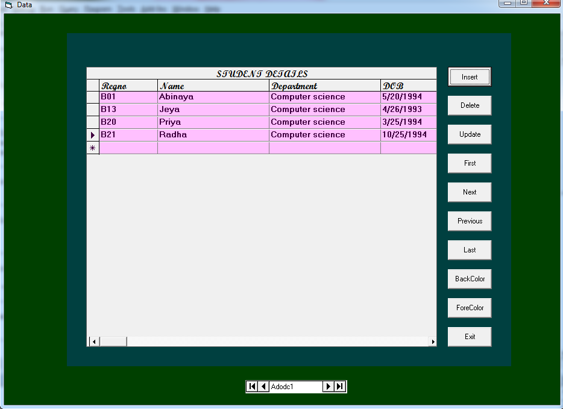

Slide 49
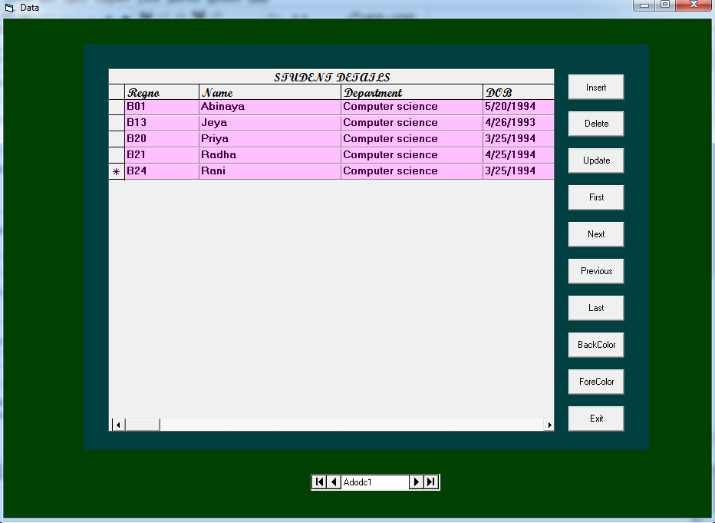

Slide 50
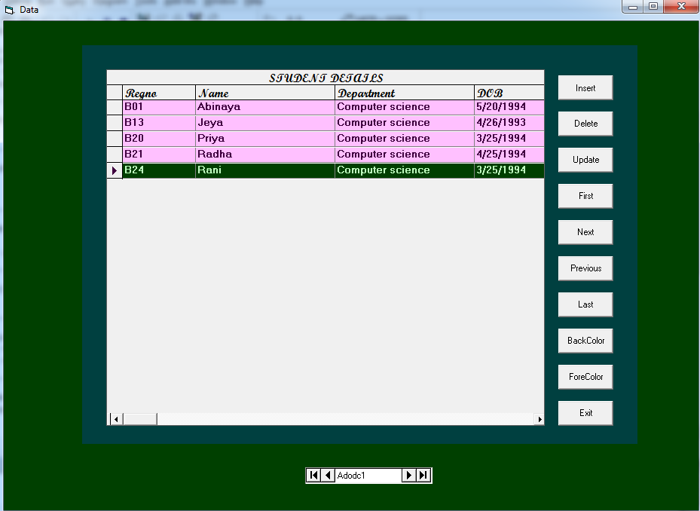

Slide 51
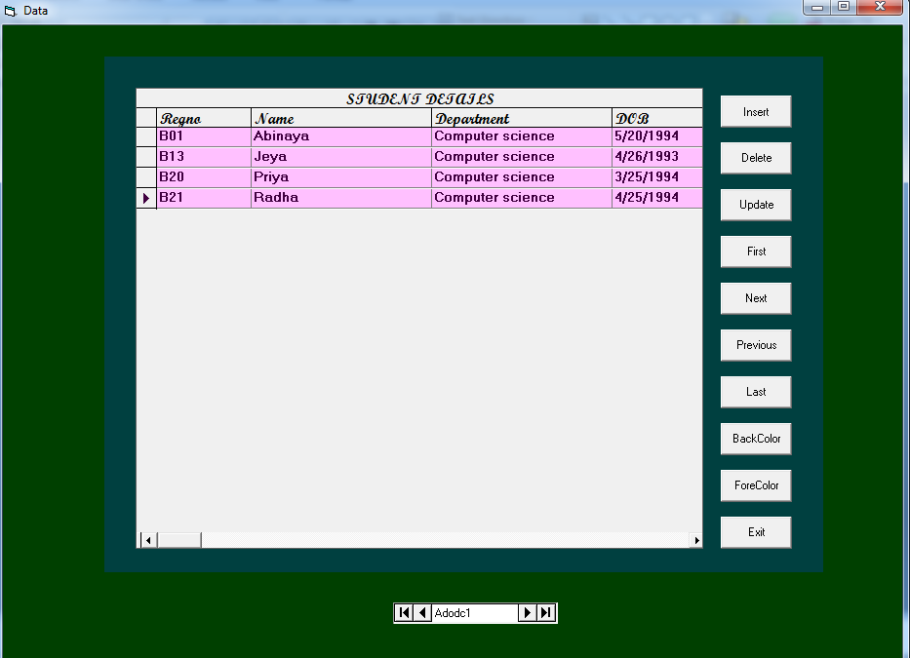

Slide 52
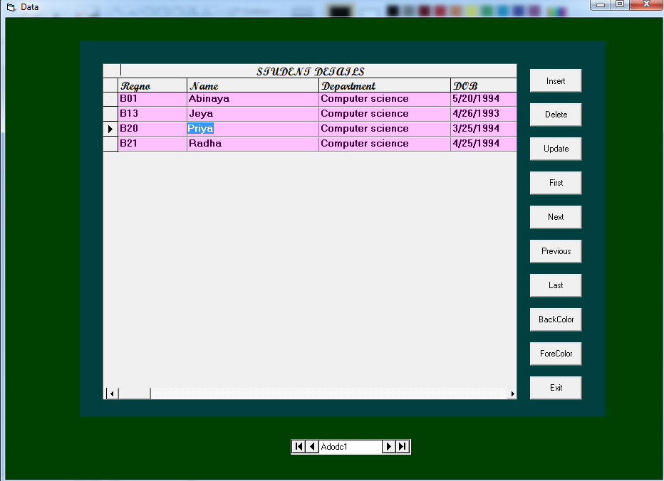

Slide 53
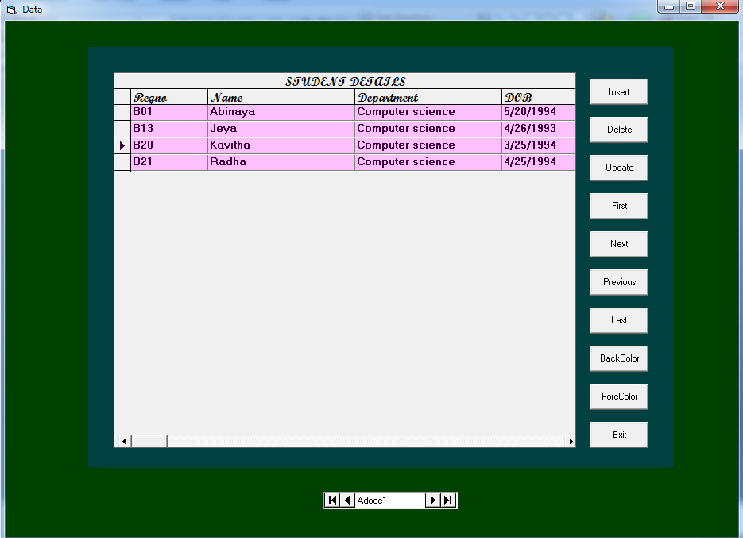

Slide 54
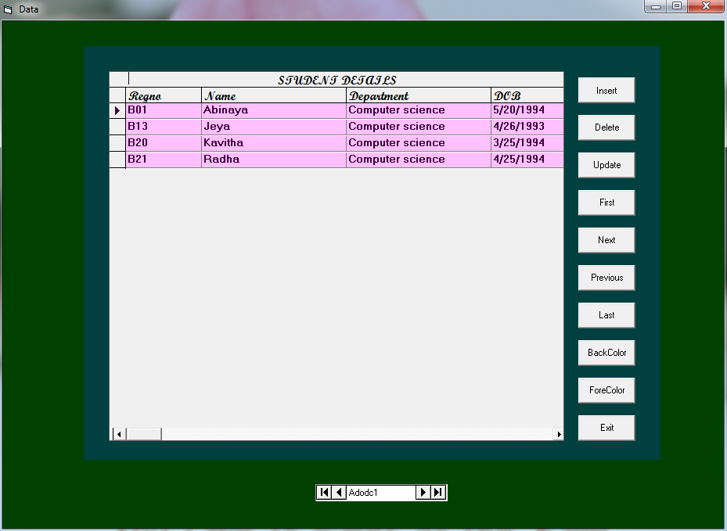

Slide 55
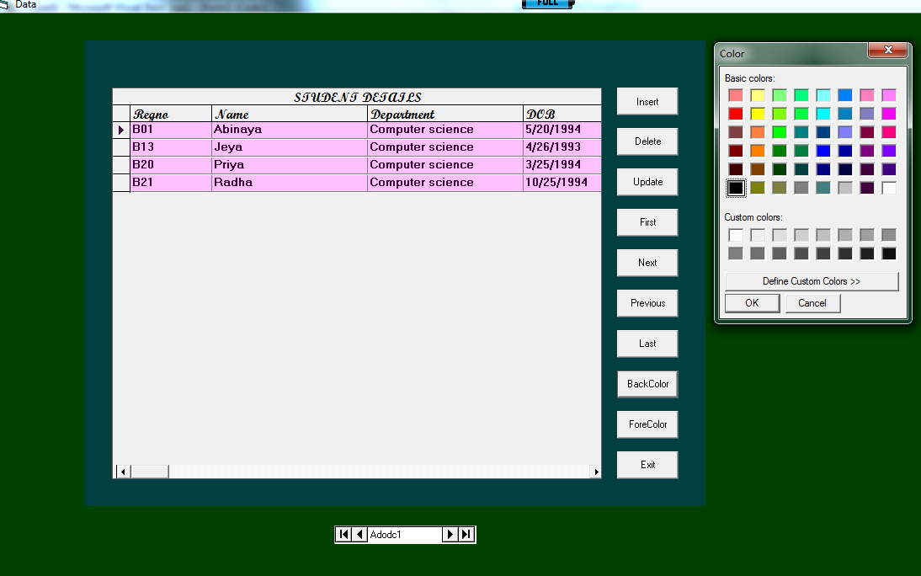

Slide 56
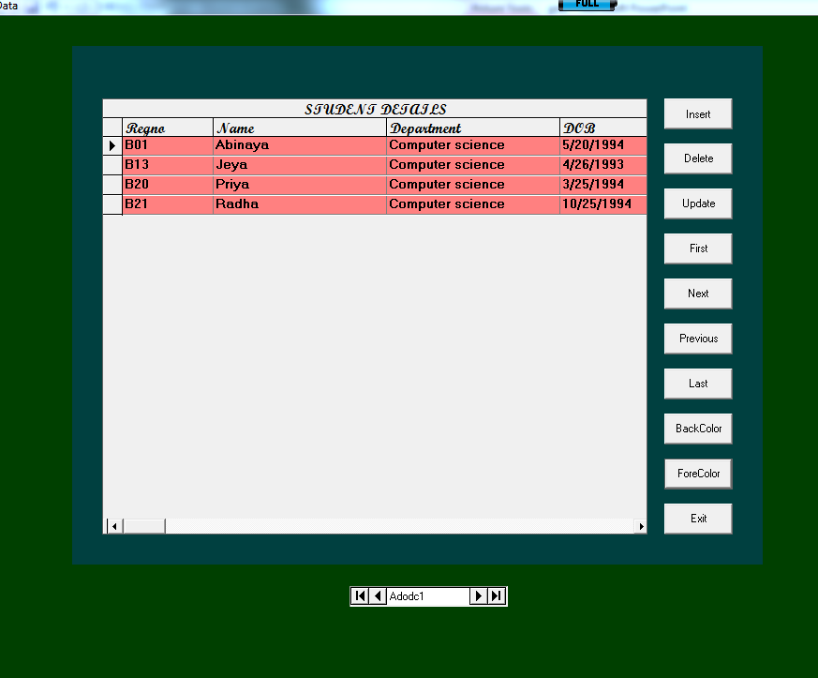

Slide 57
